Slide 1
Lecture 7
CSE 4101
Topic: The Chomsky Hierarchy of Generative Grammars, Basic Parsing techniques, Lexicon, Top-Down versus Bottom-up Parsing

Slide 2
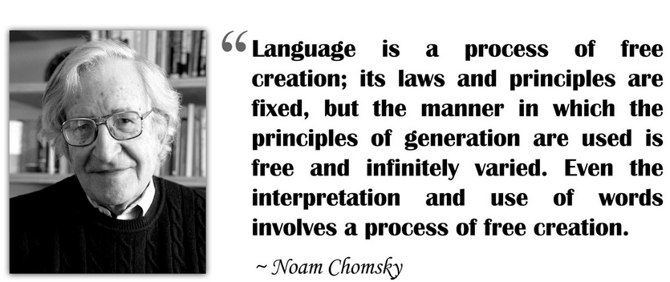
Noam Chomsky

Slide 3
Introduction
Any language is a structured medium of communication whether it is a spoken or written natural language, sign or coded language, or a formal programming language. Languages are characterized by two basic elements – syntax (grammatical rules) and semantics (meaning). In some languages, the meaning might vary depending upon a third factor called context of usage.

Slide 4
Introduction
Depending on restrictions and complexity present in the grammar, languages find a place in the hierarchy of formal languages. Noam Chomsky, celebrated with American linguist (Multilingual person) cum cognitive (Intellectual) scientist, defined this hierarchy in 1956 and hence it's called Chomsky Hierarchy.

Slide 5
The Chomsky Hierarchy of Generative Grammar
The Chomsky hierarchy was described first by Noam Chomsky in 1956. The Chomsky hierarchy classifies languages, based on the classes of generative grammars generating them.

Slide 6
Generative grammar
A generative grammar is a precisely formulated set of production rules whose output is the language that it generates. There are many different kinds of generative grammar, such as transformational grammar as developed by Noam Chomsky from the mid-1950s. Transformational grammar is basically a theory to understand the processing of grammatical knowledge in the human brain.

Slide 7
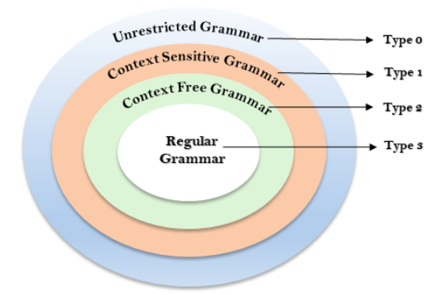
Different levels in the Chomsky Hierarchy

Slide 8
Meaning of the word context
Context is the circumstance and settings that provide background information about an statement, or idea. The context helps us fully understand something.

Slide 9
Type-0 unrestricted grammar
In type-0 the production has no restrictions. There may be any phase structure grammar which includes all formal grammars. The productions can be in the form of a→b where, a is a string of terminals and with at least one non-terminals and a cannot be empty string. b is a string of terminal and non-terminal.

Slide 10
Type-0 unrestricted grammar
They generate the language which is recognized by the Turing machine. A language is recursively enumerable (r.e.) if it is the set of strings accepted by some TM.
Example
S→ACaB
Bc→acB
CB→DB
aD→Db

Slide 11
Type-1 Context Sensitive grammar
Type 1 grammar is also known as context sensitive grammar
The CSG follows some rules, which are as follows −
  They have the added restriction that the length of the string on the right-hand side of the rewrite rule must be at least as long as the string on the left-hand side.
  The number of symbols on the left-hand side must not exceed the number of symbols on the right-hand side.

Slide 12
Type-1 Context Sensitive grammar
  The rule of the form A→ε (epsilon) is not allowed unless A is a start symbol. A does not occur on the right-hand side of any rule
  Epsilon is a zero length string and it may be used as terminal string.
  Formally, a string is a finite, ordered sequence of characters such as letters, digits or spaces. The empty string or zero length string is the special case where the sequence has length zero, so there are no symbols in the string. An empty string is represented as "". There is only one empty string.
  The type 1 grammar has to be in Type-0.

Slide 13
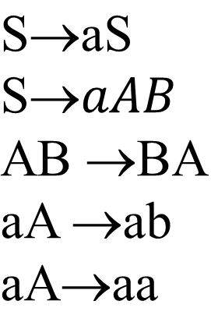
Type-1 Context Sensitive grammar-Example
Example

Slide 14
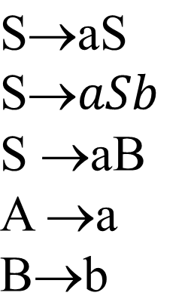
Type-3 Regular grammar
The strings that a CFG produces will contain only symbols from the set of nonterminal symbols. A set of production rules which are the rules for replacing nonterminal symbols. Production for this type take forms such as

Slide 15
Type-3 Regular grammar
Regular Grammar is the Type-3 grammar according to Chomsky Hierarchy. They have a single non-terminal symbol on the left-hand side, a single terminal on the right-hand side, or a single terminal followed by a non-terminal. contain only symbols from the set of nonterminal symbols. The production rule is of the form,
A→aB

Slide 16
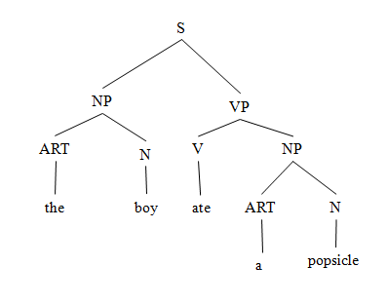
Structural representation
It is convenient to represent sentences as a tree or graph to help expose the structure of the constituent parts. For example, the sentence “The boy ate a popsicle” can be represented as the tree structure depicted in Figure below.

Slide 17
Structural representation
Such structures are also called phrase markers because they help to mark or identify the phrase structures in a sentence. The root node of the tree, in this Figure corresponds to the whole sentence S, and the constituent parts of S are subtrees. For this example, the left subtree is a noun phrase, and the right subtrees a verb phrase.

Slide 18
Structural representation
The leaf or terminal nodes contain the terminal symbols. A tree structure such as the above represents a large number of English sentences. It is convenient to represent sentences as a tree or graph to help expose the structure of the constituent parts. For example, the sentence “The boy ate a popsicle” can be represented as the tree structure depicted in Figure below.

Slide 19
Parse or Parsing
In linguistics (the scientific study of language and its structure, including the study of grammar, syntax, and phonetics) , to parse means to break down a sentence into its components parts so that the meaning of the sentence can be understood. Sometimes parsing is done with the help of tools such as sentence diagrams.

Slide 20
Parse or Parsing
When parsing a sentence, the reader takes note of the sentence elements and their parts of speech (whether a word is a noun, verb, adjective, etc.). The reader also notices other elements such as the verb tense (present tense, past tense, future tense, etc.). Once the sentence is broken down, the reader can use their analysis to interpret the meaning of the sentence.

Slide 21
Lexicon
A lexicon is a dictionary of words (usually morphemes or root words together with their derivatives), where each word contains some syntactic, semantic, and possibly some pragmatic. Information. The information in the lexicon is needed to help determine the function and meanings of the words in a sentence. Each entry in a lexicon will contain a root word called the head.
(Derivative: a word formed from another word. The word “childish” is a derivative of “child.”)

Slide 22
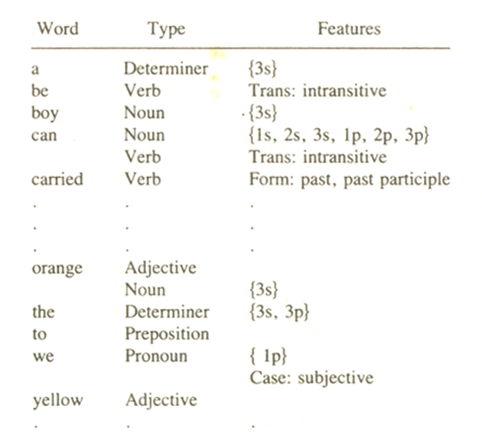
Lexicon

Slide 23
Lexicon
The abbreviations ls, 2s, . . . , 3p in Figure stand for first person singular, second person singular, . . . , third person plural, respectively. Note that some words have more than one type such as can which is both a noun and a verb, and orange which is both an adjective and a noun. Alternatively, the entries in a lexicon could be grouped and given by word category (by articles, nouns, pronouns, verbs, and so on), and all words contained within the lexicon listed within the categories to which they belong).

Slide 24
Lexicon
The organization and entries of a lexicon will vary from one implementation to another, but they are usually made up of variable length data structures such as lists or records arranged in alphabetical order. The word order may also be given in terms of usage frequency so that frequently used words like a, the, and an will appear at the beginning of the list facilitating the search.

Slide 25
Top Down versus Bottom up Parsing
There are 2 types of Parsing techniques present parsing, the first one is Top-down parsing and the second one is Bottom-up parsing.
Top-down parsing: Begin with the start symbol and apply the grammar rules forward until the symbols at the terminals of the tree correspond to the components of the sentence being parsed.
Bottom-Up parsing: Begin with the sentence to be parsed and apply the grammar rules backward until a single tree whose terminals are the words of the sentence and whose top node is the start symbol has been produced.

Slide 26
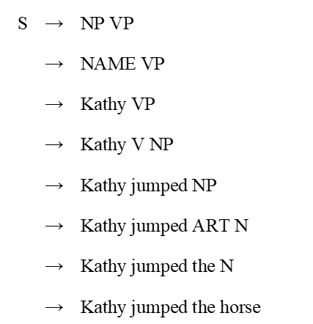
Example of Top Down Parsing

Slide 27
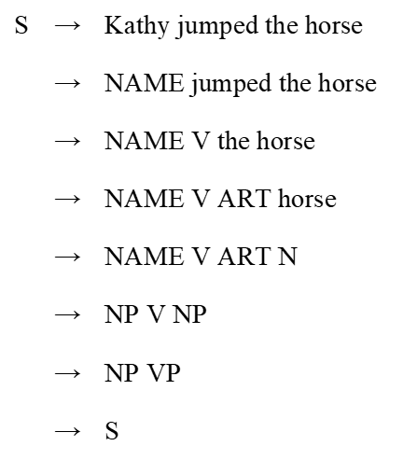
Example of Bottom Up Parsing

Slide 28
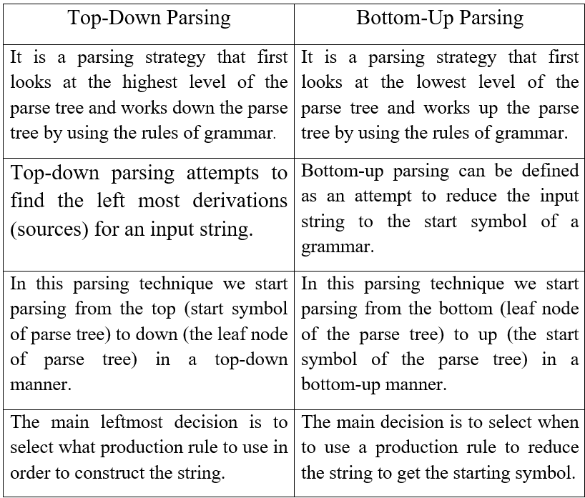
Example of Bottom Up Parsing

Slide 29
End

